Slide 1
Nov 4 Field-Aligned Electrons
C. Schiff – 3/1/16 v0.0

Slide 2
Status
Based on meetings on 2/18/16 and 2/29/16 generated the following from Fast Survey data for Nov 4, 2015 02:00-04:00
PAD (PSD-based and Count-based)
???

Slide 3


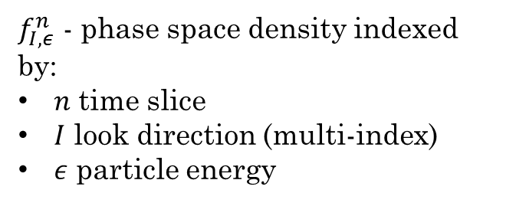
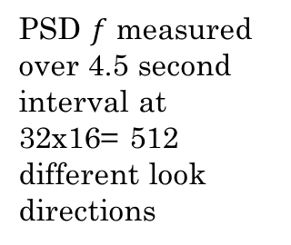

FPI Skymaps
PSD $f$ measured over 4.5 second interval at 32x16= 512 different look directions
Polar Angle $θ$
$f_{I,ε}^{n}@ (φ_{i},θ_{i},$)
Azimuthal Angle $φ$
Nov. 4th FS data from 02:00-04:00 has:
1019 time samples (4.5 duration)
512 look directions
32 energies
$f_{I,ε}^{n}$ - phase space density indexed by:
$n$ time slice
$I$ look direction (multi-index)
$ε$ particle energy

Slide 4
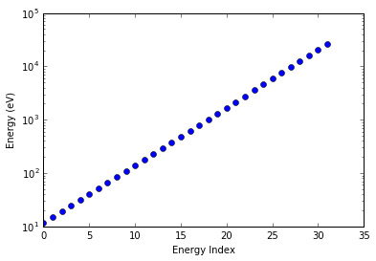
Sampled Energies
32 energies
Range from 11.6 eV – 20.25 keV
The lowest 12 energies:
11.6, 14.9, 19.1, 24.5, 31.5, 40.4, 51.7, 66.4, 85.1, 109.1, 140.0, 179.5

Slide 5
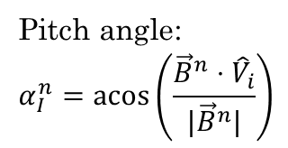
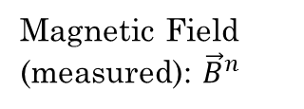
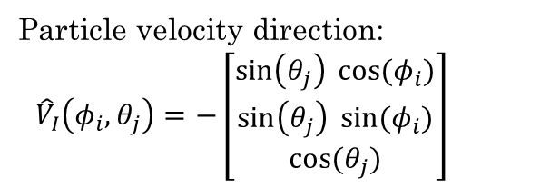

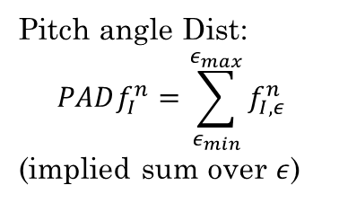
FPI Skymap Transformation
PSD $f$ measured over 4.5 second interval at 32x16= 512 different look directions
Polar Angle $θ$
$f_{I,ε}^{n}@ (φ_{i},θ_{i},$)
Azimuthal Angle $φ$
Particle velocity direction:
${\hat{V}}_{I}\left(φ_{i},θ_{j}\right)=−\left[\begin{matrix}\sin\left(θ_{j}\right) cos⁡(φ_{i}) \\ \sin\left(θ_{j}\right) sin⁡(φ_{i}) \\ cos⁡(θ_{j})\end{matrix}\right]$
Pitch angle Dist:
$$PADf_{I}^{n}=\sum_{ε_{min}}^{ε_{max}}{f_{I,ε}^{n}}$$
(implied sum over $ε$)
Pitch angle:
$$α_{I}^{n}=acos\left(\frac{{\vec{B}}^{n}⋅{\hat{V}}_{i}}{|{\vec{B}}^{n}|}\right)$$
Magnetic Field (measured): ${\vec{B}}^{n}$
Flatten and plot v. $α_{I}^{n}$

Slide 6
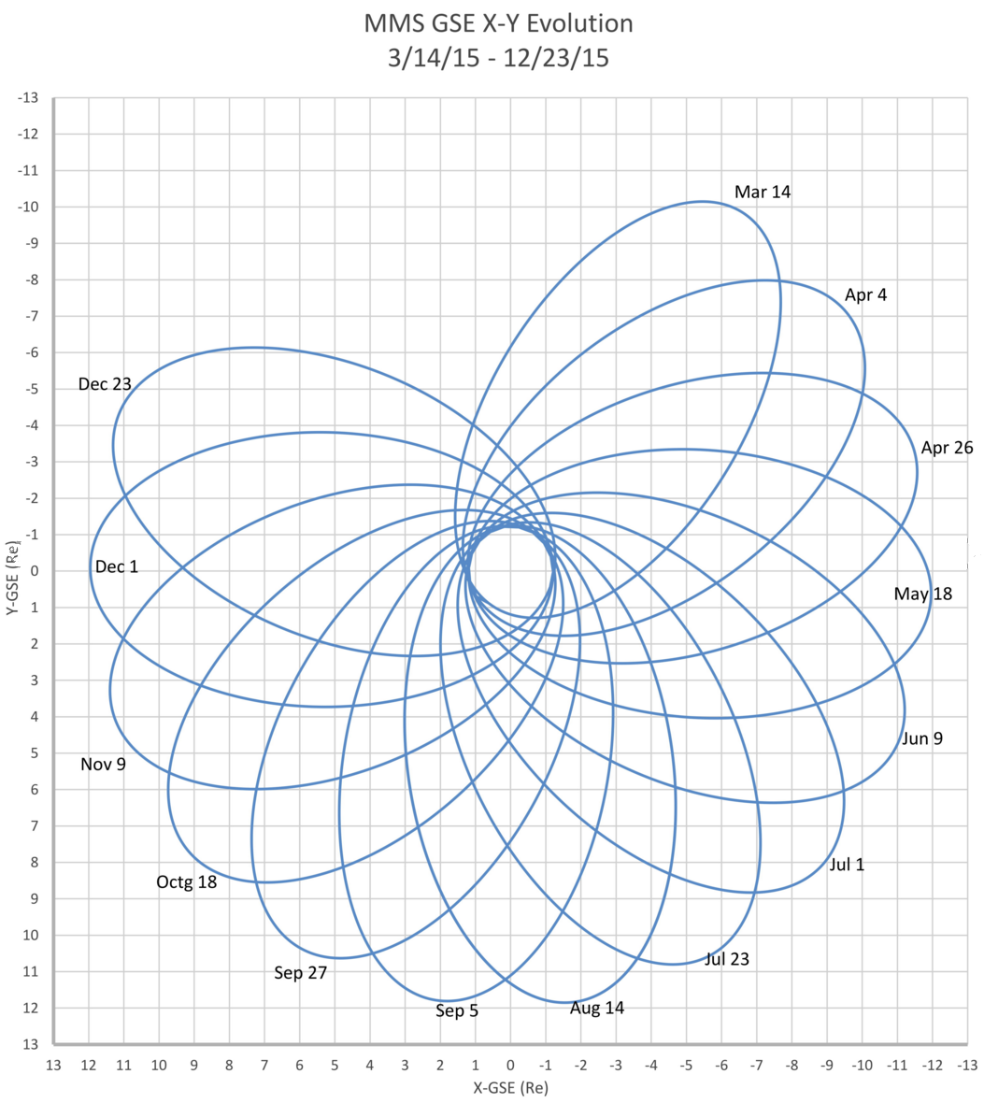
Orbit Geometry and Approximate Candidate Location
11/4

Slide 7
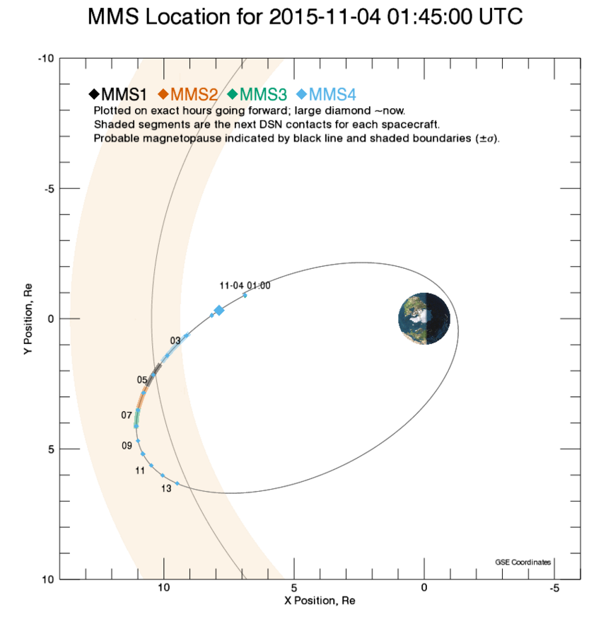

Slide 8
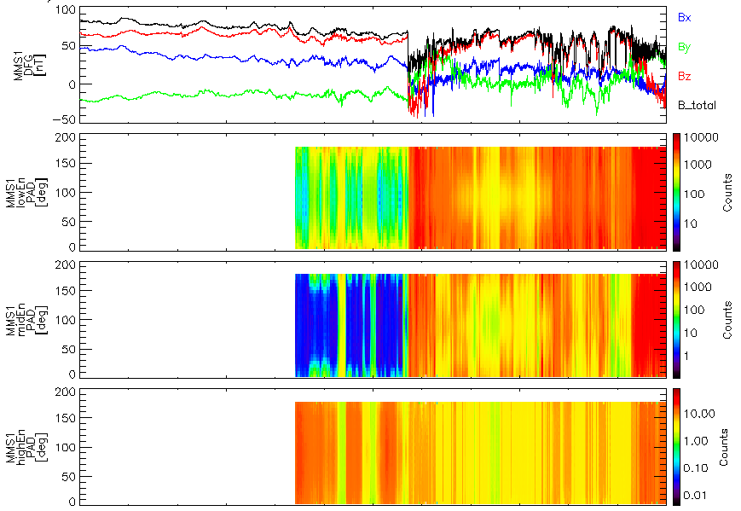
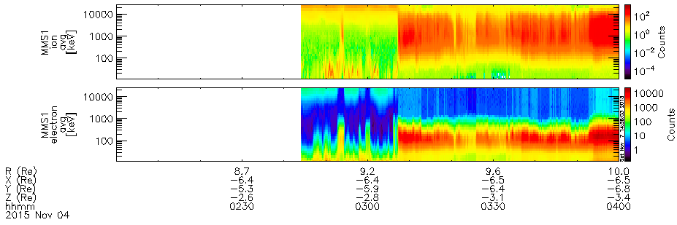




Nov 4 – 02:00-04:00
$$\vec{B}$$
$$E_{low}:10…200 eV$$
Pitch Angle Dist.
$$E_{med}:200…2000 eV$$
$$E_{hi}:2…30 KeV$$
E-t spectrogram (ions)
E-t spectrogram (electrons)

Slide 9
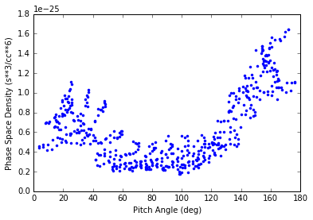
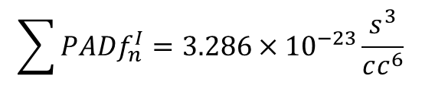
Some Examples: 2016-11-04 02:44:20.360556
Summed over the 1st 12 energies
(11eV-179.5eV)
$$\sum{PADf_{n}^{I}=3.286×{10}^{−23}\frac{s^{3}}{cc^{6}}}$$

